Slide 1
Towards Automatic Numerical Cross-Checking: Extracting Formulas from Text
Yixuan Cao, Hongwei Li, Ping Luo, Jiaquan Yao
Key Lab of Intelligent Information Processing of Chinese Academy of Sciences (CAS)
School of Management, Jinan University
Notes:
Good afternoon everyone. I am Caoyixuan from institute of computing technology of Chinese academy of science. This is a joint work with Li Hongwei, Luo Ping, and Yao Jiaquan.
The title of our paper is, “towards automatic numerical cross checking. Extracting formulas from text”. Our goal is to achieve automatic numerical checking, and the specific problem we introduce in this paper is how to extracting formulas from text.

Slide 2
Part 1
Background & Problems
Notes:
First, I want to talk about the background, and the problem we want to solve.

Slide 3
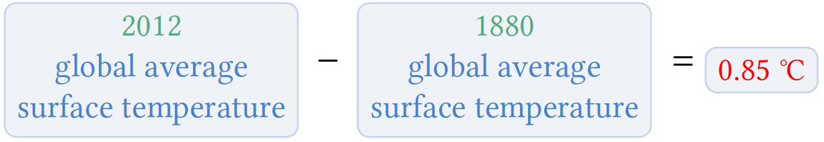
1. Background
Claims over numerical relationships (formulas)
In science
In the period from 1880 to 2012, the global average (land and ocean) surface temperature has increased by 0.85 ℃.
Notes:
Claims over the numerical relationships widely exist in the published documents on Web. ## For example, in science, sentence like this: in the period from eighteen, eighty to twenty twelve, The global average surface temperature has increased by zero point eighty five degree Celsius. It claims a numerical relationship that the temperature in eighteen eighty minus the temperature in twenty twelve is zero point eighty five degree Celsius.

Slide 4
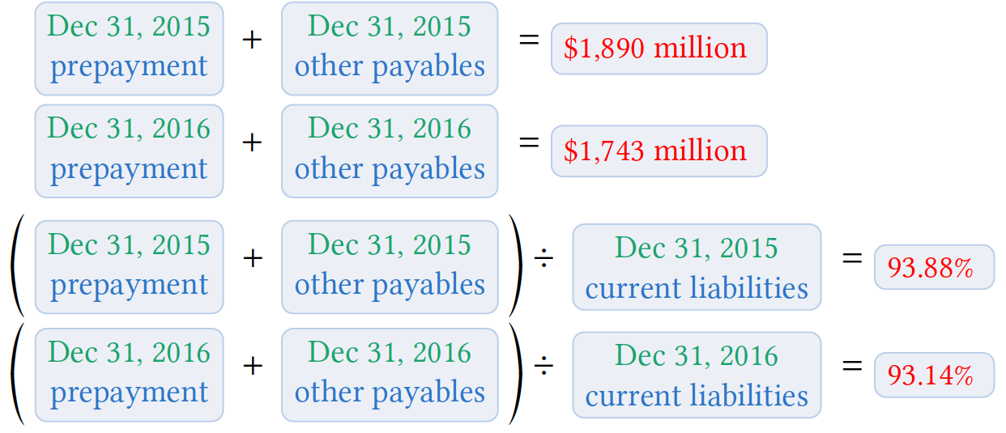
1. Background
Claims over numerical relationships (formulas)
In Finance
For the years end December 31, 2015 and December 31, 2016, we had prepayment and other payables in an aggregate amount of approximately $1,890 million, $1,743 million, constituted 93.88% and 93.14% of current liabilities, respectively.
Notes:
And similar claims exist in financial documents too. Like: For the year twenty fifteen, and twenty sixteen, we had prepayment and other payments in aggregate amount of approximately One number, another number constitute some percent and some Percent, of current liabilities respectively.
There are four formulas claimed in this sentence, two summations, and two divisions.
This paper we focus on formulas in financial documents.

Slide 5
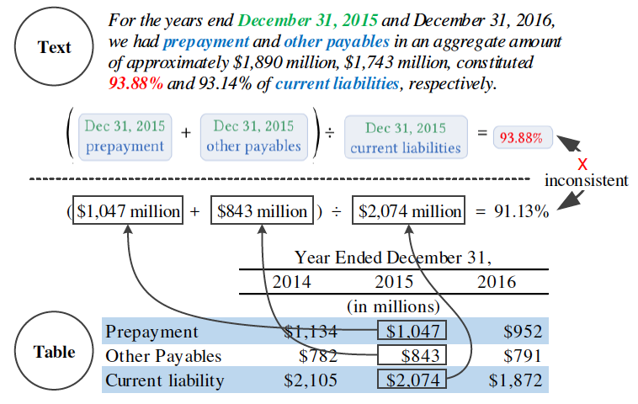
1. Background
Numerical Cross-Checking (NCC)
1. What ? Claims in text vs Structured data
Notes:
The wild existence of claims of formulas give birth to the demand for Numerical cross checking. ## What is numerical cross checking? ## The sentence we saw in last slide are based on the table in the same document, as shown below. It contains basic indicators like prepayment, other payables. Now we have two representation of the same data, in text and in table, so we need to make sure that these two are consistent. This is what NCC do: cross-check the consistency between text and structured data.

Slide 6
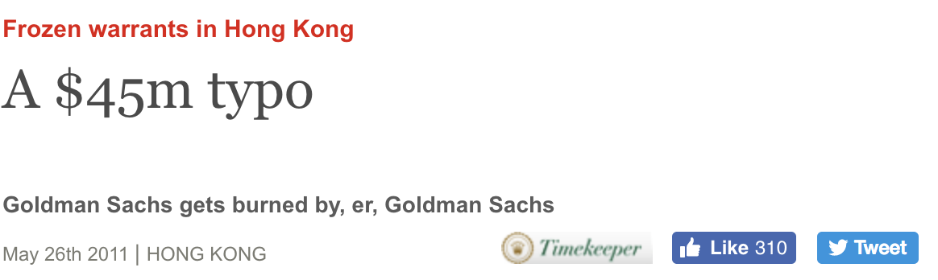
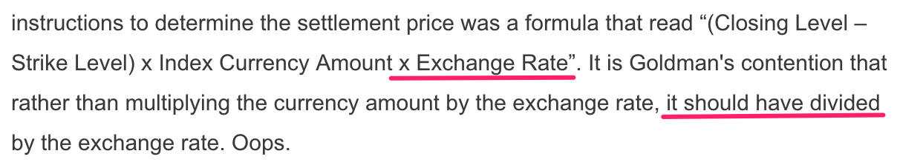
1. Background
Numerical Cross-Checking (NCC)
2. Why ? Inconsistency may cost a lot
Screenshot from www.economist.com
Notes:
The next question would be why, why do we need NCC. The short answer is inconsistency may cost a lot.
A very famous example is that in twenty eleven, goldman sachs made a typo which cost it forty five million dollars.
// Published financial documents are the most important way for investors to understand a company.
Even immaterial errors in the document could damage the company’s reputation.

Slide 7
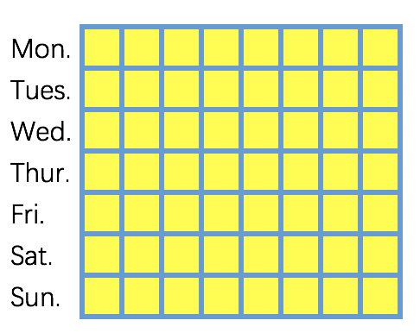
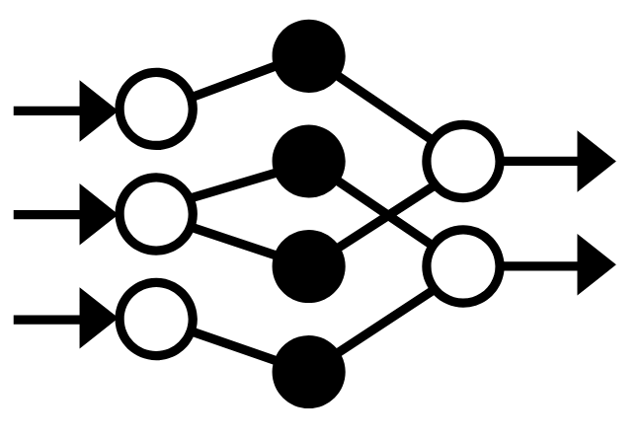

1. Background
Numerical Cross-Checking (NCC)
3. How ? Manual (Time-consuming, Laborious, Error-prone) vs Automatic
≈ 1 Week
3-year experience
< 1 Hour
Notes:
// Two ways: manually and automatically. But manual checking has some intrinsic limitations: time-consuming and laborious.
The demand for NCC is high. So how do we conduct it?
##
The traditional way is to do it manually, in finance there is a special job called authorized reading. ## On average, an employee have to take a week to cross check a five hundred page document. (500 pages is a typical number of pages in Chinese bond prospectus). It is really time consuming and Laborious.
The second way, the new way we come up with, is to do it automatically. ##. The system we built can do the same job in less than one hour, usually a few minutes. That means you upload your document, have a coffee and the cross checking work is done.

Slide 8
1. Background
Numerical Cross-Checking (NCC)
3. How ? Manual (Time-consuming, Laborious, Error-prone) vs Automatic
≈1,000 officially published Chinese prospectus
68.92% with data-inconsistency errors
4.26 errors per document on average
Notes:
And more importantly, manual checking is error prone. This is obvious. Imagine you need to check a document of five hundred pages, hundreds of numbers and formulas, for about a week. Every human being will get tired and bored. Then mistakes are made.
We run our system on about a thousand of officially published Chinese prospects. ## And found that, nearly seventy percent of them, have data inconsistency errors.
// These errors are confirmed by professionals.
So it is really the time that we need to abandon the time consuming, laborious and error prone manual cross checking ##, ##and embrace the automatic system.

Slide 9
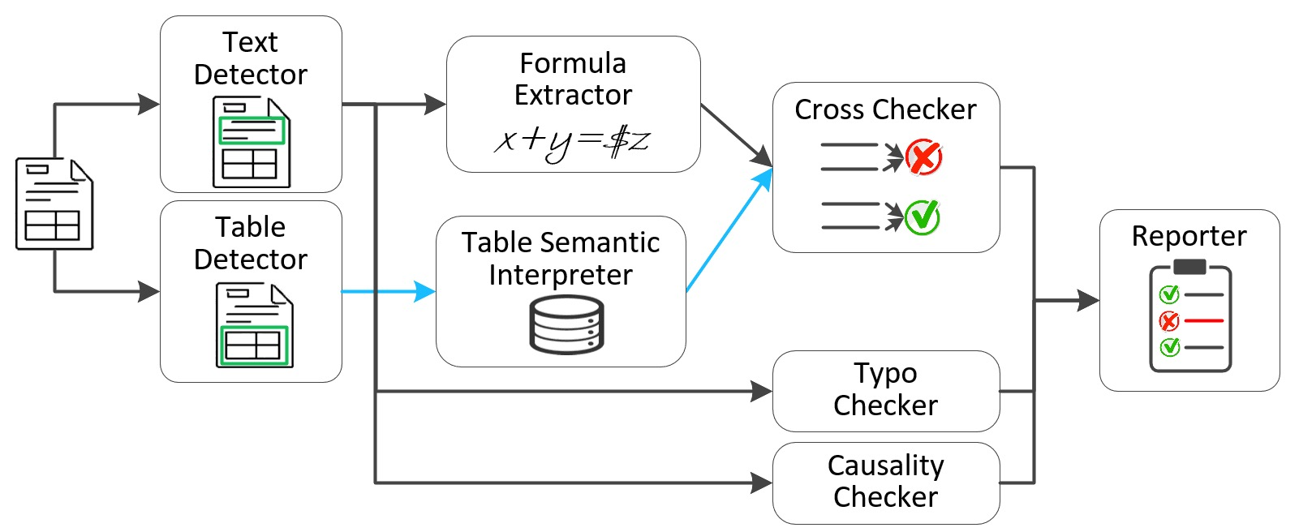
1. Background
Automatic Numerical Cross-Checking System
Notes:
The system we build structured like this.
1 From left to right. When a document is upload into our system, the first thing is to analyze its structure. We use two detectors to extract text and table respectively.
2 Then the formula extractor extract formulas described in text, and the tables semantic interpreter extract the data from table.
3 Then the cross checker matching and evaluating to check the consistency between formulas and structured data. Besides that, our system are also able to do typo checking and causality checking.
4 Finally the results of these checkers are summarized into a report, where users can review easily and interactively. I will show it at the end of my presentation.
##
Today, we focus how to extract formulas from text.
In this part we know that we need an automatic numerical cross checking system, and we need to extract formulas from text.

Slide 10
Part 2
Formulation & Solution
Notes:
The second part, we introduce the problem formulation and solution of formula extraction problem.

Slide 11
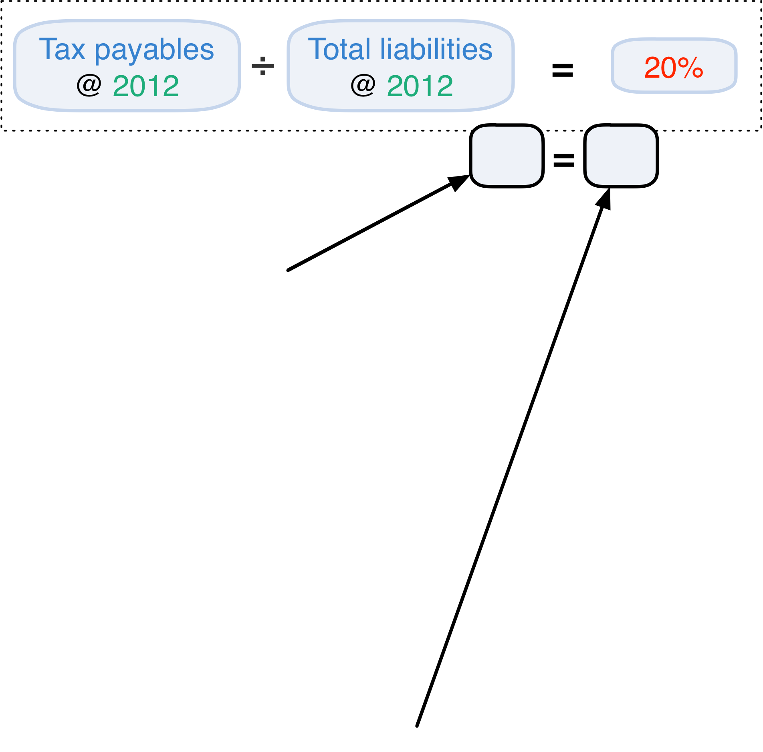
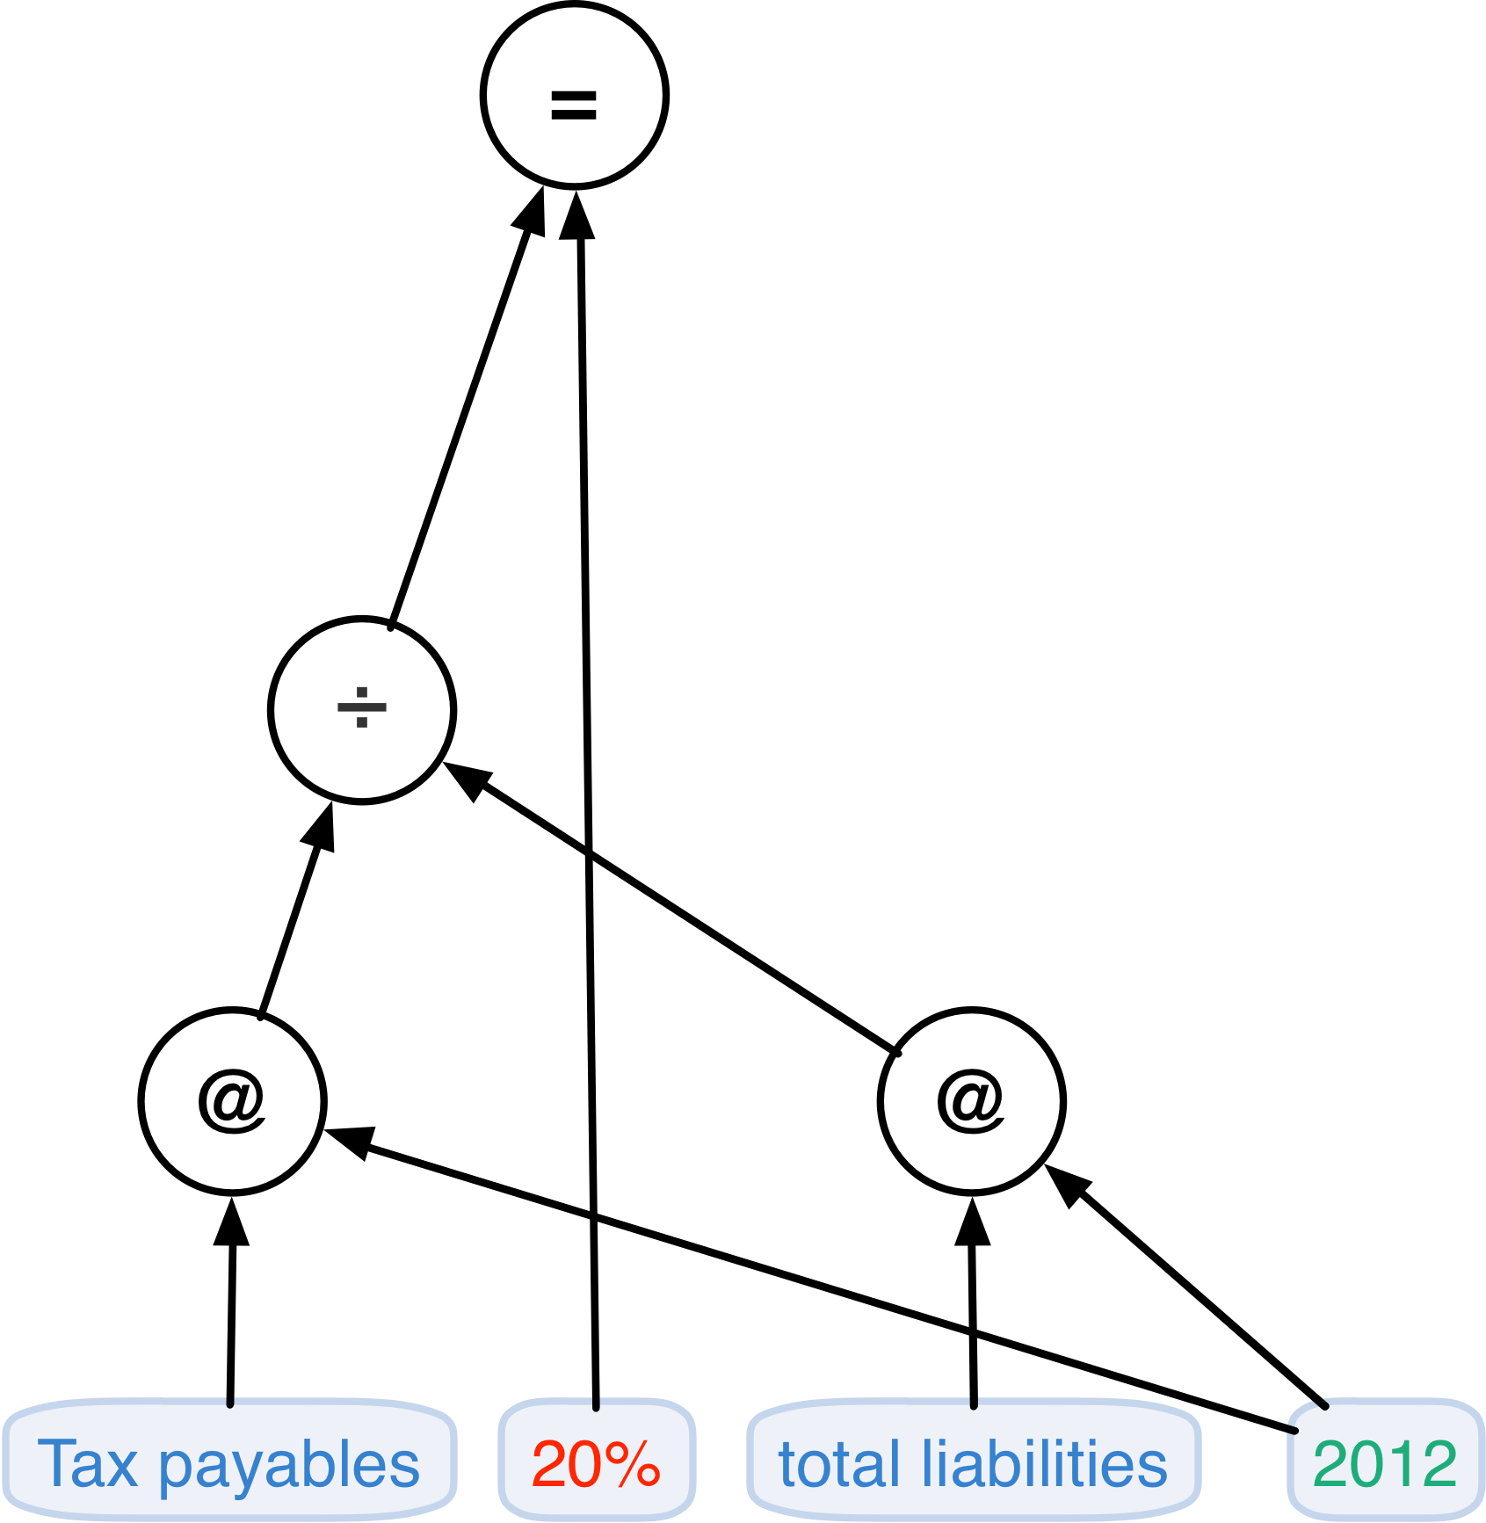
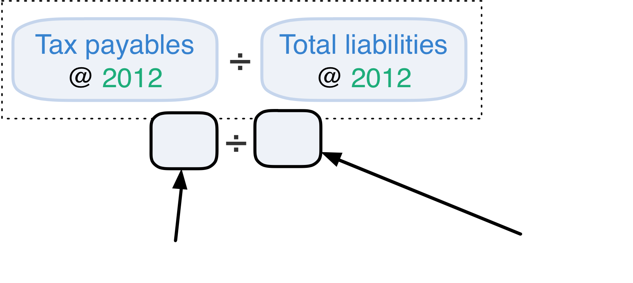
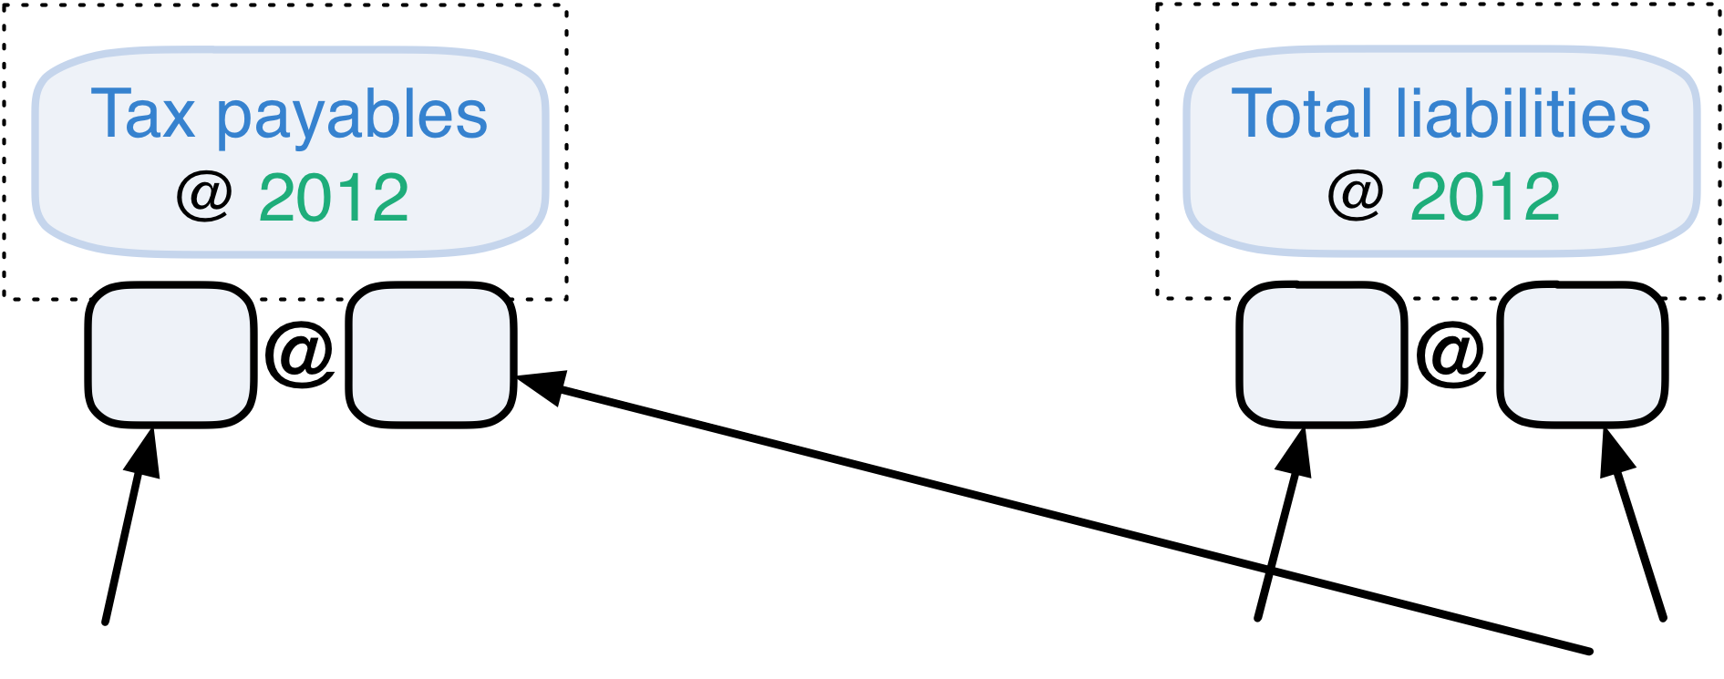
2. Solution
Formulas = Directed Acyclic Graph
Notes:
We found the best way to express a formula is using directed acyclic graph.
Why ? Let’s consider a simple sentence.
##
Tax payables constitutes twenty percent of total abilities in twenty twelve. It express a formula, the division equals twenty percent. ##
But let’s define the formula step by step.
First, two financial indicators are mentioned,## that are tax payables at twenty twelve, and total liabilities at twenty twelve. Then there is a ## division between them, and finally this division ## equals the number twenty percent. If we remove the text, it becomes clear that, ## the formula is a DAG structure.
// Each node in the structure have two children and is associated with some operators, like, equality and division.
This is a simple example to show the idea. In practice, the structure is usually much more complicated,

Slide 12
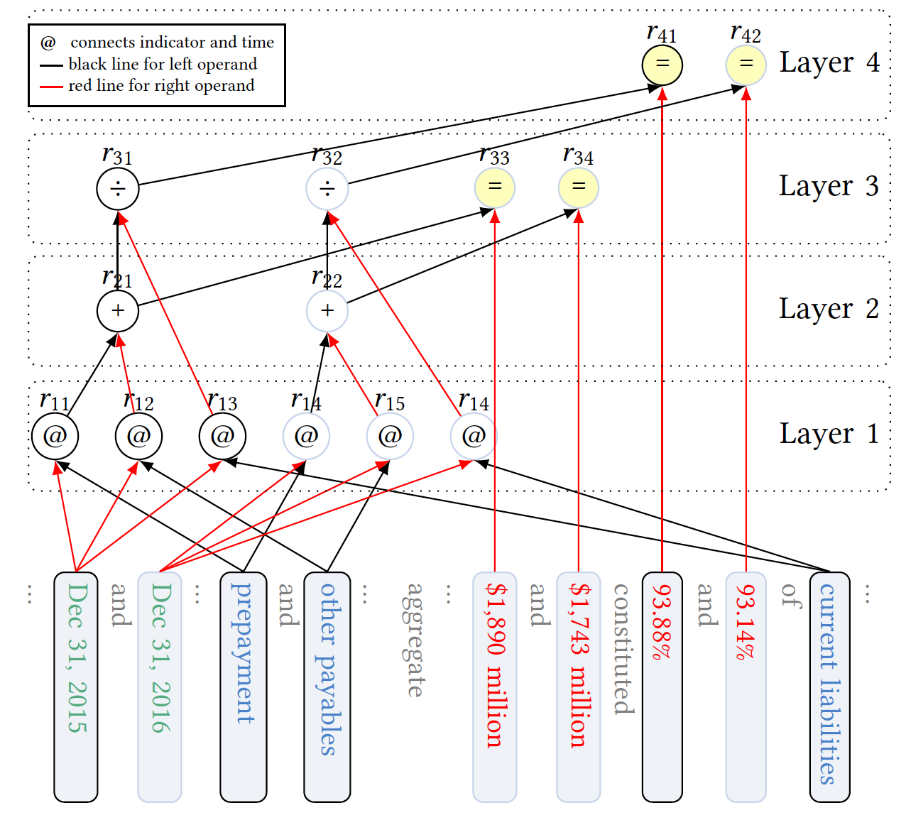
2. Solution
Formulas = Directed Acyclic Graph
Notes:
like this. You can see this node ## has two parents, and ## this structure have four roots. Therefore using DAG to represent formula is necessary.
// But in this report, we will stick with the simple one.
So the formula extraction problem is DAG structure extraction problem.

Slide 13
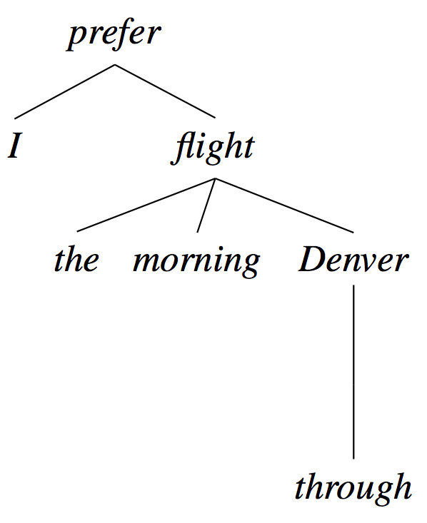
2. Solution
Related fields
Relation Extraction
Output: triple ( Tail entity, Type, Head entity )
Syntactic Parsing
Output: Tree structure
Semantic Parsing
Natural language to DB queries for question answering
Natural language to semantic structure
Equation Parsing
Word problem: There are 6 chickens and some rabbits in a cage. 20 feet in total. How many rabbits are there in the cage ?
*
* Figure from Speech and Language Processing. by Daniel Jurafsky & James H. Martin.
Notes:
Before we introduce our solution I want to mention some of the related fields.
##
The first is relation extraction. This is an old topic in NLP. It extract relationships between two entities from a sentence. Our formula extraction problem can be viewed as extracting nested relationships, that is relation of relations. But this has not been study in the relationship extraction field.
##
The second one is Syntactic parsing. But its result is constrained to be a tree. This is not enough for formula extraction.
##
Another field is semantic parsing, this is a broad concept.
// And it’s task include from natural language to database queries for a question answering, from natural language to some semantic structure.
Our problem is a semantic parsing task.
##
And a closely related topic is called equation parsing. But research on this is relatively rare. They focus merely on word problems. Their method and result are preliminary, and far from industry deployment.
So there are no off the shelf methods, that are just fit for formula extraction problem.
https://web.stanford.edu/~jurafsky/slp3/14.pdf

Slide 14
2. Solution
Extract DAG structure from text
Bottom up, Iterative layer by layer, classify candidates
Notes:
So we come up with our approach. It can be summarized into three key words: that are bottom up, iterative layer by layer, and classify candidates.
Let me demonstrate the extraction process by the example we have just seen. #click#
The bottom is the sentence. In layer 1, we make two candidates, that are tax payables in 2012 and total liabilities in 2012. And we classify them.

Slide 15
2. Solution
Extract DAG structure from text
Bottom up, Iterative layer by layer, classify candidates
Notes:
And find that they are correct.

Slide 16
2. Solution
Extract DAG structure from text
Bottom up, Iterative layer by layer, classify candidates
Notes:
In layer 2, we generate many candidates like tax payables minus 20%, tax payables divide total liabilities, or plus it, and so on.

Slide 17
2. Solution
Extract DAG structure from text
Bottom up, Iterative layer by layer, classify candidates
Notes:
Then after classification, only one node is correct.
That is the division node.

Slide 18
2. Solution
Extract DAG structure from text
Bottom up, Iterative layer by layer, classify candidates
Notes:
In layer 3, we can also generate many candidates, like the result of division plus 20%, equals 20%, larger than 20%, and so on. Then we classify these candidates

Slide 19
2. Solution
Extract DAG structure from text
Bottom up, Iterative layer by layer, classify candidates
Notes:
and only equality relation is correct. Then no more candidate can be generated, so the process terminates.
In summary, the process starts from the bottom, and iterative layer by layer. At each layer it generates candidates and then classify them, until reaching the top.
That is the overview of the process. The question you may ask is: how to predict whether a candidate is correct or not?

Slide 20
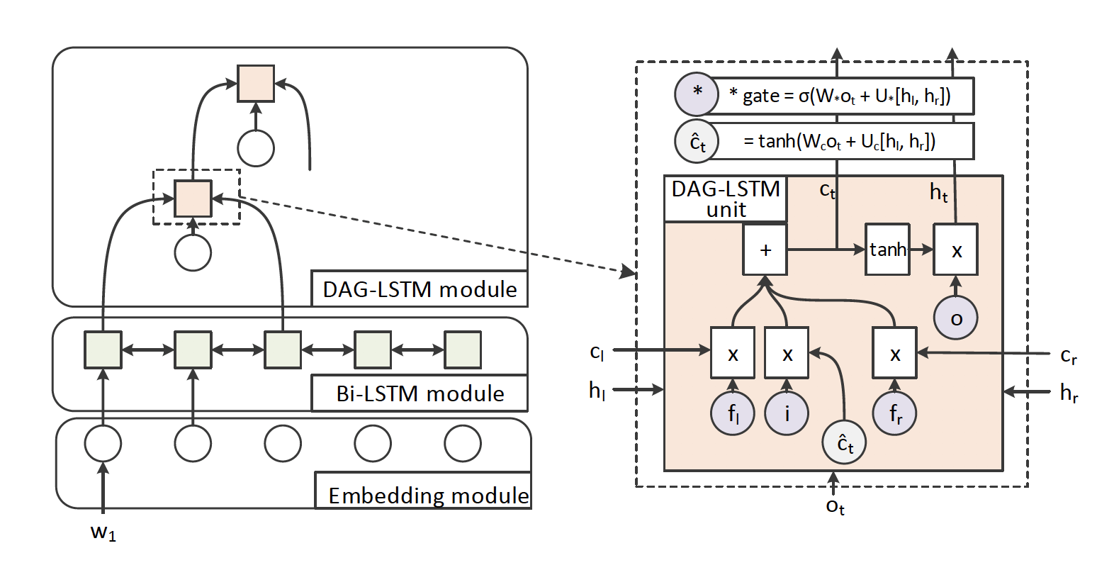
2. Solution
Extract DAG structure from text
Bottom up, Iterative, classify candidates, DAG-LSTM
Notes:
We turn to deep learning models. First we use bi-directional LSTM to compute hidden states (or vectors) of each word. Then we use DAG-LSTM, which is a variance of LSTM, that can handle the case of two children. It takes as input two vectors of its children and compute a new vector to represent this node. Then the vector is feed into a classifier to predict whether correct or not.
// If you don’t know LSTM or RNN, you can imagine that each node is a function that take two vectors as input, and return a new vector as output, that output is the representation of the node.
OK, in this part, we formulize formula extraction as a DAG structure extraction problem. And come up with our approach to solve it, in an interactive way.

Slide 21
Part 3
Experiment & Analysis
Notes:
Now let’s evaluate our solution by experiment.

Slide 22
3. Experiment
Data & Result
Relation Level |  |  | Formula level |  |  | Sentence level
Precision | Recall | F1 | Precision | Recall | F1 | accurancy
97.78% | 98.33% | 0.9806 | 96.53% | 96.45% | 0.9649 | 92.02%
Notes:
We have tens of thousands of sentences with their formulas manually labelled. ##
// Figure a)And b) are the distribution of sentences versus the number of words and number of relations in a sentence.
From the distribution of sentences, we can see that sentence can be very long, and contain more than 50 relations.
So the problem is non-trivial.
##
But the result is promising.
// The F1 score at relation level is 98, at formula level is more than 96.
//Relation level means each node in DAG is a sample, we do the binary classification, and measure F 1 score. Formula level means each root of DAG is a sample, only when all of its descendants are correct we judge it as correct.
And at sentence level, on more than ninety two percent of sentences we can extract formulas exactly the same as labelling result.
This performance is actually higher than human beings from our observation.
// Moreover, the online system usually perform better than this. Because the training set have some bias towards long sentences.

Slide 23
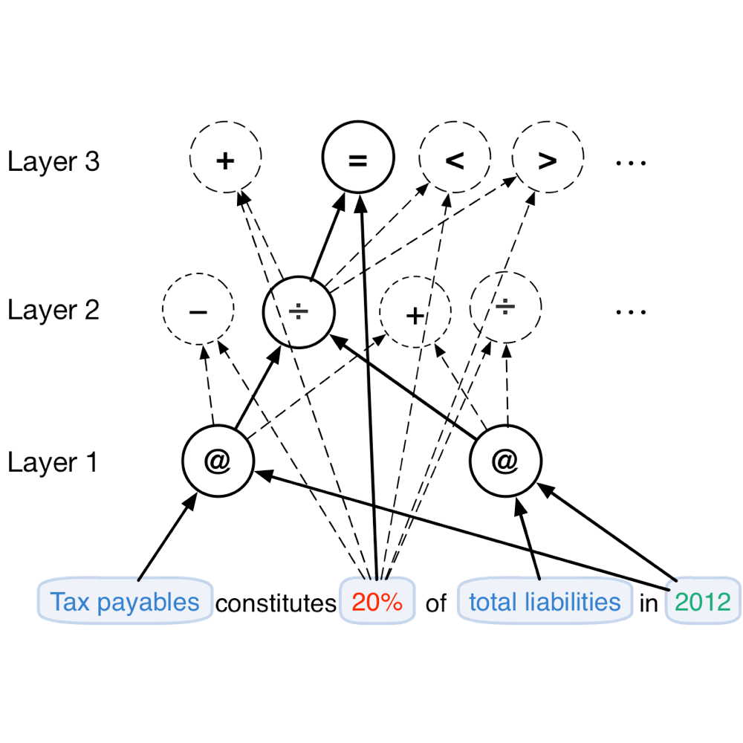
3. Experiment
Speedup
common structure, topology order
Notes:
So that is the result, on more thing is the time performance.
We find that the training process is really slow. This a also the bottle neck of all non-sequential structure deep learning models.
The common approach is to compute them sequentially.

Slide 24

3. Experiment
Speedup
common structure, topology order
Notes:
But we can do better, cause nodes in the same layer are independent, and we can compute them in parallel.

Slide 25
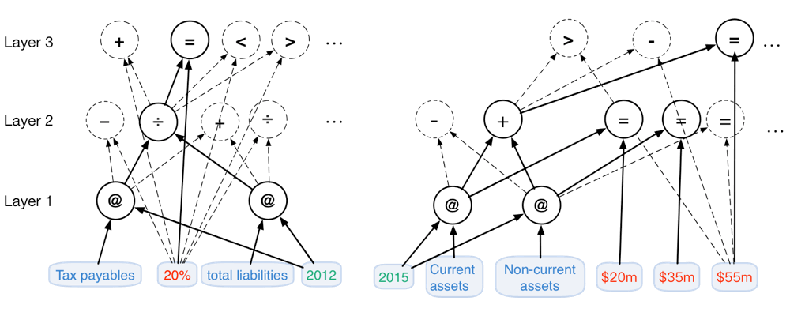
3. Experiment
Speedup
common structure, topology order
Notes:
Furthermore, a batch of sentences, nodes in the same layer can be computed at the same time.

Slide 26
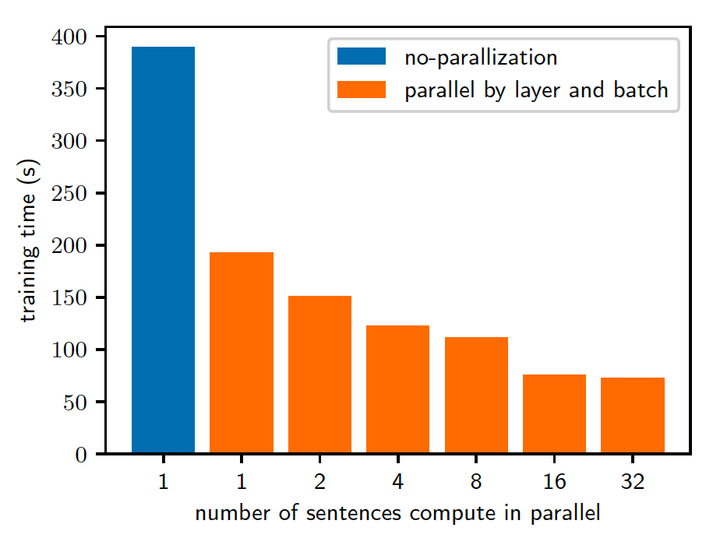
3. Experiment
Speedup
common structure, topology order
Notes:
These parallelization is possible because ## all nodes share the same common structure, and same computation process.
##
This parallelized implementation can be up to 5 times faster than sequential one.

Slide 27
Current status of our system (since Apr. 2017)
> 1 K users
> 3 K documents uploaded
Notes:
Finally I want to talk about the current status of our system.
Since available online in April last year, we already have more than one thousand users, over 3 thousands of documents have been uploaded and analyzed . On the other hand, the number of bonds issued in China last year is less than 2 thousands. Therefore we are covering a large portion of practitioners and documents in this field.
Currently we only analyze Chinese, but we are planning to support English in the near future.
In this document, we can see we find many error, (tav 1) This one, the number of this indicator it write is this, but in table, the number is different.
A more complicate case, the result of a division is not consistent. We can see that the value of divisor appear in the sentence, and the dividend appear in a table. We can easily see the value in table with a click, instead of scrolling up and down in a document with hundreds of pages.

Slide 28
Thanks for listening !
Notes:
So this is our presentation, thank you for your listening!!

